Slide 1


"Data Leakage Detection"
Prepared by:
Shubham Shekhaliya
(U18CO018)
Guided by:
Mrs Sachi Shah

Slide 2

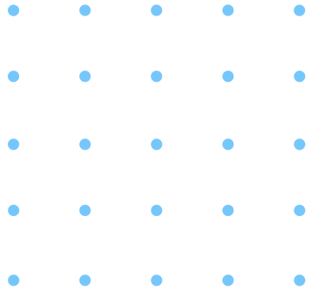




Which Type of Data can get leaked?
Personal information of customers
Business plans
Financial conditions
Various Document/Proofs of Users
Information of patients
credit-card data of employees
Payment details
Future Plans of Companies

Slide 3

What does means by data leakage?
getting access to essential data of an organization by unauthorized users
Trusted third-party agents?
Faulty/Untrusted/Guilty agents?

Slide 4
A relevant and crucial problem
Parent sites & their third party applications
develop Some techniques
Parent sites can identify the Guilty agents
Motivation
PITCH DECK V 1.0

Slide 5


Literature Survey
Various method
MAC address
AES Encryption Algo.
Digital watermark
Based on the Overlapping

Slide 6
Literature Survey
MAC address & AES Encryption Algo.
Without adding fake objects or calculating guilt probability
encrypts the potential content
MAC address is used to identify the guilty agent

Slide 7
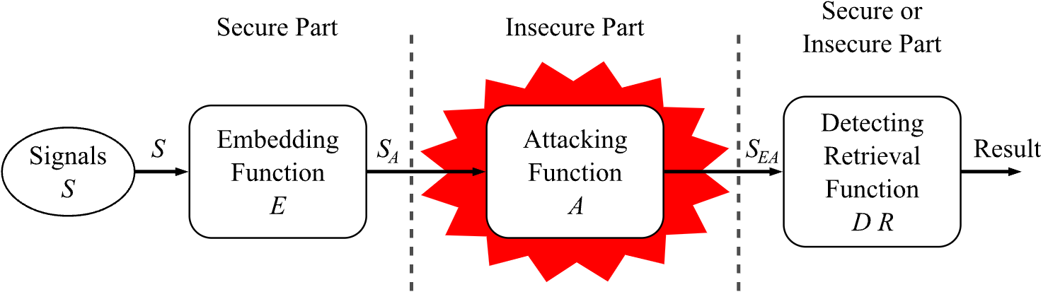
Literature Survey
Digital watermark
Identify the guilty agent using a unique code
Simple solution
Can be tampered & completely destroyed
Digital Watermark life cycle

Slide 8
Literature Survey
Based on the Overlapping
Overlapping of agent data with the leaked data
Various data distribution techniques
Distributing objects thoughtfully can improve detecting guilty agents

Slide 9
Data leakage Detection Techniques
Sample Data Request
Problem Definition
needs to specify the number of data records
Consider that agents A1, A2, …. An request the data from the distributor
possessing a set of objects, say D = { d1, d2,…., dm }
data set S has been found leaked
Explicit Data Request
based on a condition that the agent can explicitly ask for particular data

Slide 10
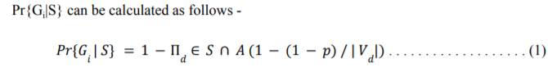
Data leakage Detection Techniques
Let the event that agent Ai is guilty be Gi and the event that agent Ai is guilty of a given leaked set S be Gi|S
Agent Guilt Model Analysis
agent Ai is guilty if it contributes one or more objects to the leaked data set
Pr(Gj | S = Ai) or simply Pr(Gj |Ai) is the probability that agent Ai is guilty
Where Vd is the number of agents that are requesting every element that is in the leaked set S.

Slide 11
Data leakage Detection Techniques
2. Data Allocation Problem
implementing and verifying the allocation strategies for sample data requests
round-robin
three new techniques

Slide 12
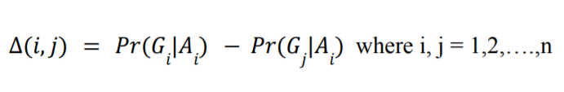
Data leakage Detection Techniques
Pr(Gj |Ai) is the probability that agent Aj is guilty if the distributor discovers a leaked table S containing all Ai objects
We define the different functions Δ(i,j) as
3. Optimization Problem
it is crucial to identify the possibility of any sort of leakage in which some of the agents were involved in a particular leaked set of S.
If the agent that leaked the data is to be identified, then the minimum value of Δ(i, j) should be maximized
Δ(i, j) is a metric for assessing the guilt of an agent
Δ(i, j) is positive for agent Aj whose set does not contain all data of the leaked set.

Slide 13
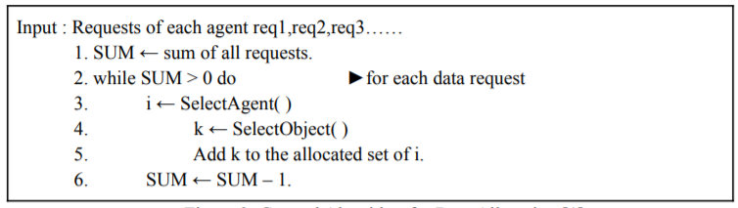
Data Allocation Strategies
General Algorithm
Time complexity O(η λ SUM)
where η = running time of SelectAgent()
λ = running time of SelectObject()

Slide 14
Object Allocation
s-random
satisfies agents’ requests but ignores the distributor’s objective.
randomly selects an object from the distributor’s data set
It may yield a poor data allocation.
Time Complexity:- O(1)

Slide 15
Object Allocation
2. s-overlap
If we keep in memory the set of k objects allocated to the least number of agents
Time Complexity:- O(1)
Each agent can receive a distinct data object
creates a list of data objects that have the least number of agents
an object randomly selected from this subset

Slide 16
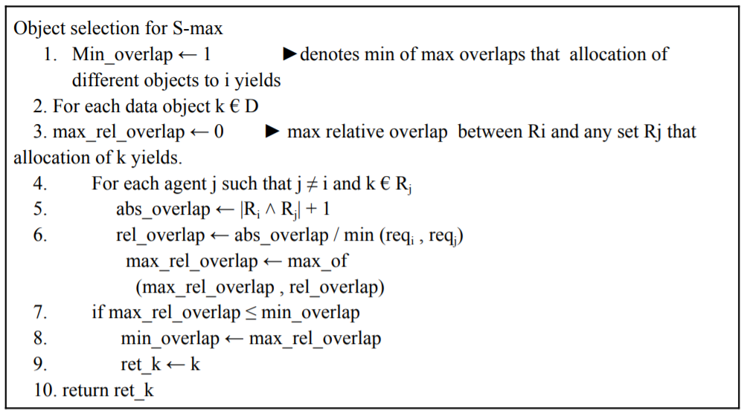
Object Allocation
3. s-max
allocate the object that provides the minimum
increase of the maximum
relative overlap
Time Complexity:- O( |D| n)

Slide 17



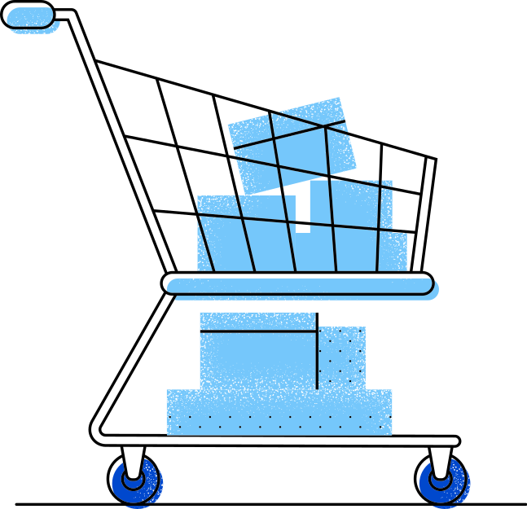
Agent Selection
1. Round Robin
allocate one data object to each agent
a significant disadvantage is the first one has to wait till all agents get one object
2. First Come First Serve (FCFS)
satisfy an agent before allocating any data object to the following agent
the agent requesting earlier does not need to wait for other agents

Slide 18
Agent Selection
3. Longest Request First (LRF)
order the agents in decreasing order of their requests, and then the served as in FCFS
the agent with the highest request does not need to wait for other agents
it may give poor allocation
4. Shortest Request First (SRF)
agents with the smaller size of requests are satisfied first completely

Slide 19
Agent Selection
Algorithms Comparison
The SRF allocation is better than the LRF allocation
In LRF A1 = {d1,d3,d4} , A2 = {d1,d4}
In SRF A2 = {d1,d4}, A1 = {d1,d3,d4}
In LRF allocation completely overlap can occur, but in SRF, there is no complete overlapping

Slide 20
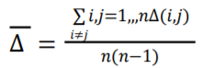
Algorithms Analysis
measure the algorithm performance and implicitly evaluate how effective the approximation
The average of Δ(i, j) values for a given allocation, and it shows how successful the guilt detection is, on average

Slide 21
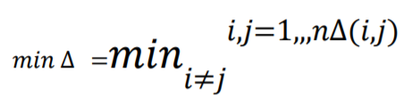
Algorithms Analysis
2. min Δ is the minimum Δ(i, j) value
If min Δ is small, then we will be unable to identify i as the leaker versus j.

Slide 22
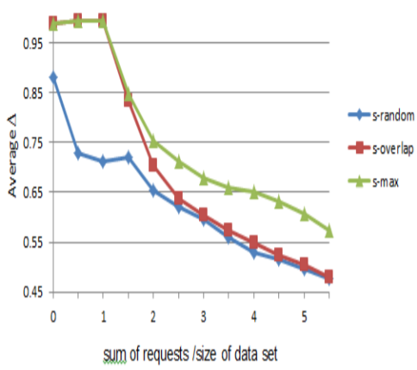
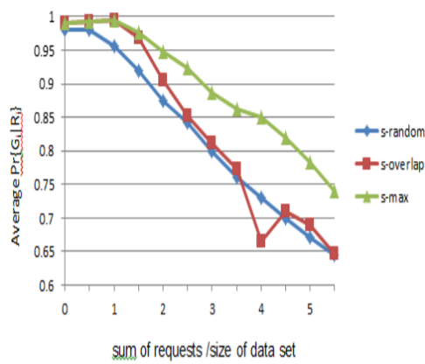
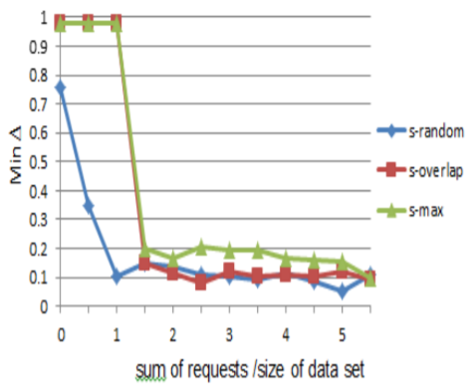
Algorithms Analysis
Evaluation of Data Requests with Round-Robin technique
(a) Average Δ
(b) Average Pr{Gi|Si}
(c) Average minΔ

Slide 23
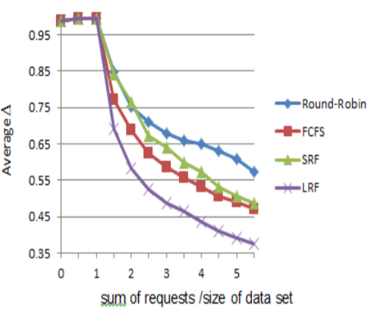
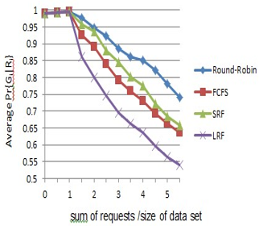
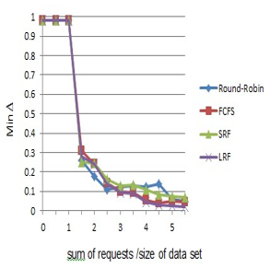
Algorithms Analysis
Comparison of Round-Robin, FCFS, SRF and LRF techniques
(a) Average Δ
(b) Average Pr{Gi|Si}
(c) Average minΔ

Slide 24
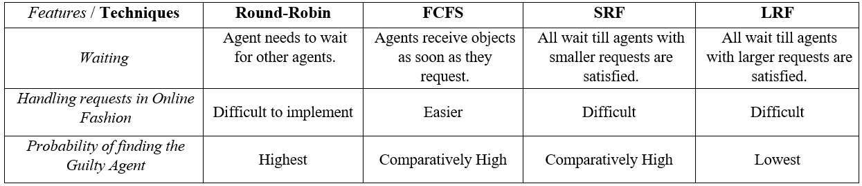
Algorithms Analysis
Comparison of existing and the different proposed techniiques

Slide 25

Conclusion
can use any technique depending on needs
distributing data carefully may improve the chances of detecting the agents
s-max better than the s-overlap and s-random
all the techniques show the same performance in the case of s-overlap
Round-Robin and SRF perform somewhat better than the other two in the case of s-max
the SRF technique must be used to improve the chances of identifying the leaker

Slide 26
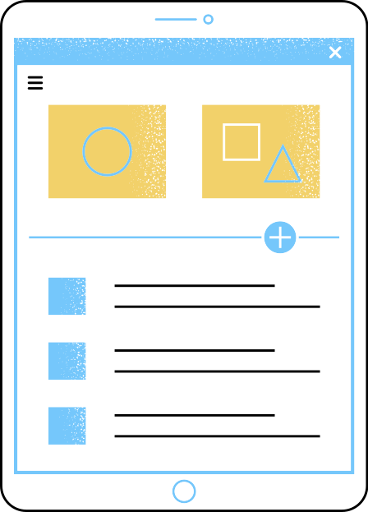


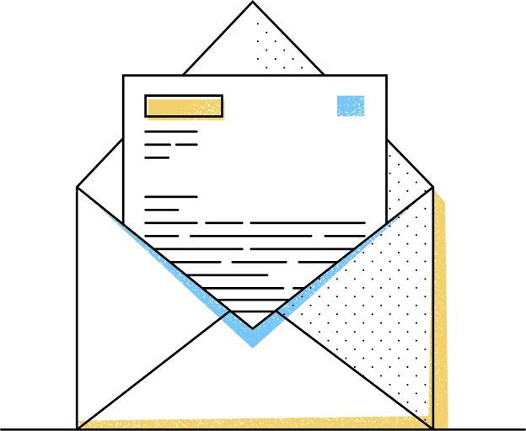

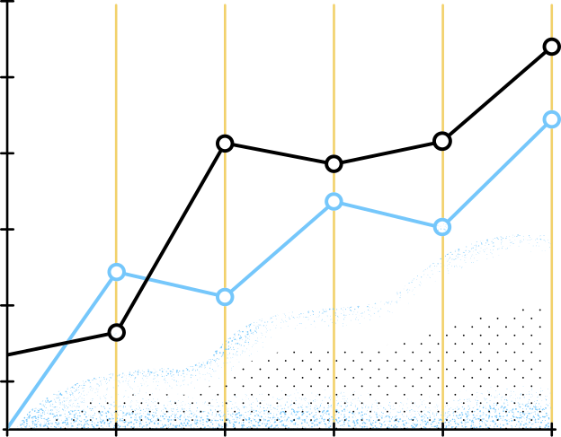


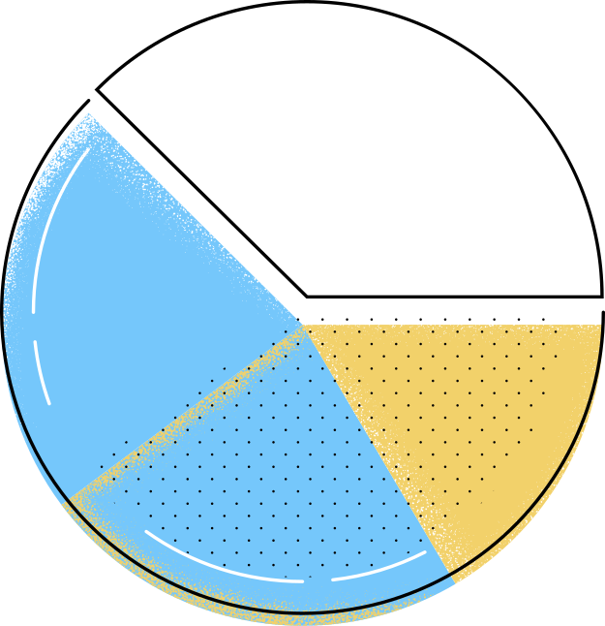
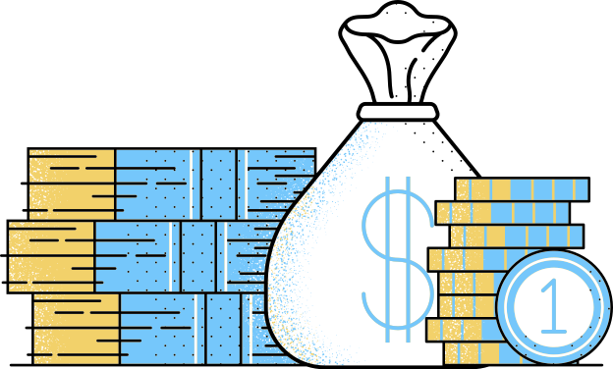

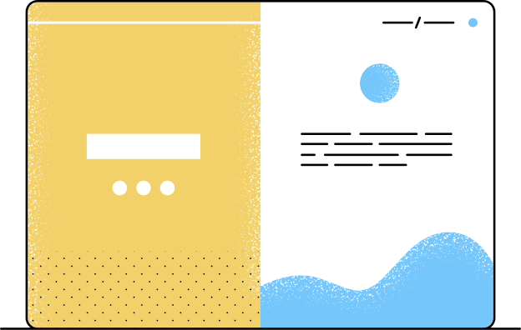


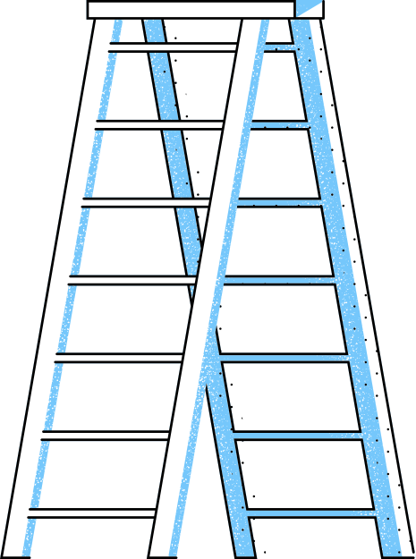
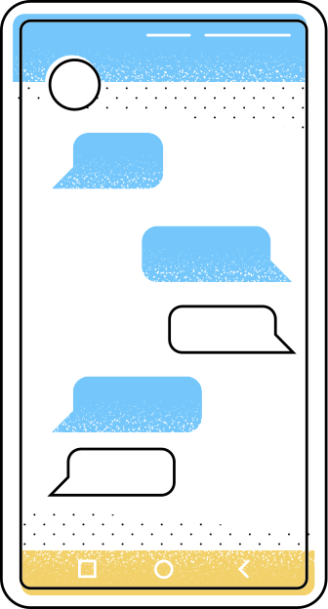
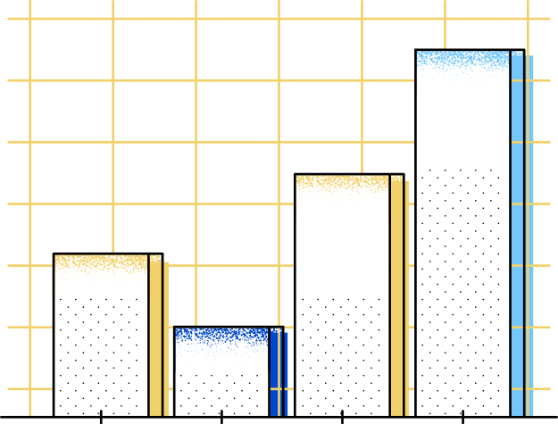
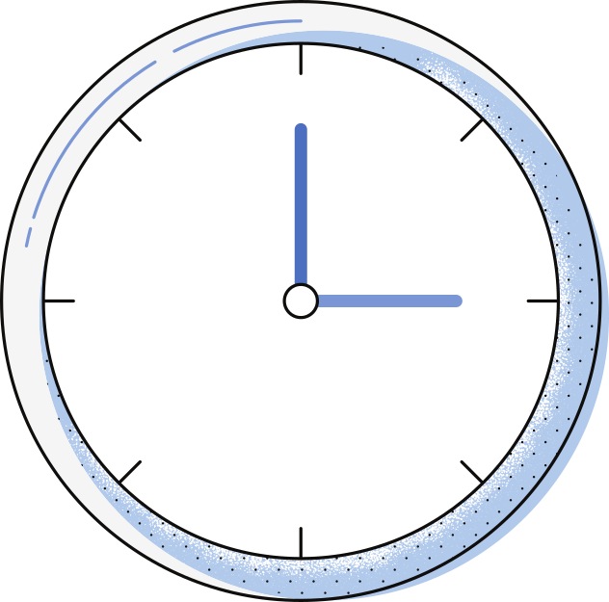
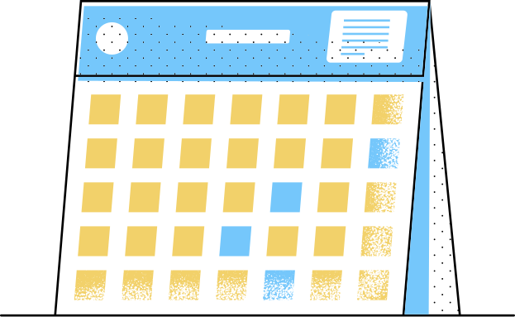

Thank You

